Slide 1
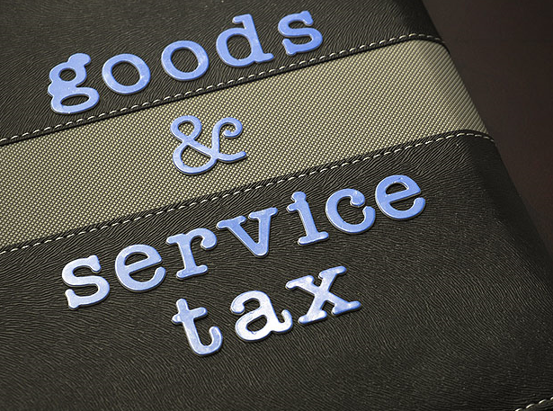
Important Case Laws –

Slide 2
List of Sources –
Supreme Court
High Court
Few AAR decisions

Slide 3
Focus Period –
Year 2017 to 2024

Slide 4
Huge damage to the National Exchequer… - What should be the contents of a SCN?
Shall we list
out quickly?

Slide 5
Notice and order for demand of amounts payable under the Act.
142. (1) The proper officer shall serve, along with the—
(a) notice issued under section 52 or section 73 or section 74 or section 76 or section 122 or section 123 or section 124 or section 125 or section 127 or section 129 or section 130, a summary thereof electronically in FORM GST DRC-01

Slide 6
What about a general notice/order (other than for demand)?
Registration,
Enquiry,
Confiscation,
Audit or Enquiry etc,
Reference to any other general provision shall not be relevant herein.
Do not forget the settled legal maxim “Generalia Specialibus Non Derogant”

Slide 7
GST Notices
Demand Notices U/R 142 (1a)
Other notices in certain circumstances U/S 169
Common Portal
E Mail
Registered Post / Speed Post
Messenger
Affixing on Notice Board of the PO
GST Common Portal
GST Notices
and Orders

Slide 8
Whether the valid service of notice has never been disputed at all?
Akash Garg Vs State of Madhya Pradesh 2020 (MP HC)
Juhi Industries Ltd Vs State of Jharkand 64 GSTL 406 (Jharkhand) 2022
Shri Tyres* Vs STO (2021) 133 Taxmann.com 319 (Madras HC)

Slide 9
Whether CBIC has not advised as to the ‘valid service of notice by GST Common Portal’ at all?
Ref: Instruction No 4 – F No 20016/41/2023 -CBIC

Slide 10
What kind of extra ordinary notices you come across in practice?

Slide 11
What kind of extra ordinary notices you come across in practice?

Slide 12
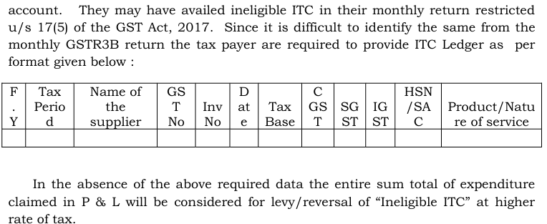
What kind of extra ordinary notices you come across in practice?

Slide 13
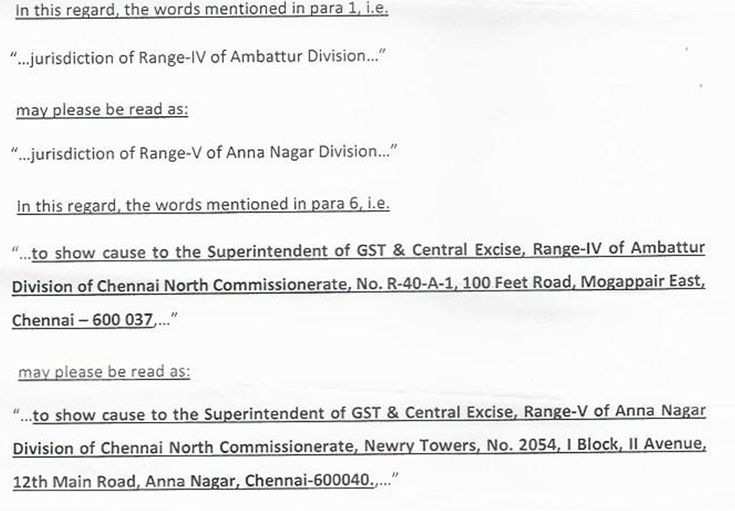
What kind of extra ordinary notices you come across in practice?

Slide 14
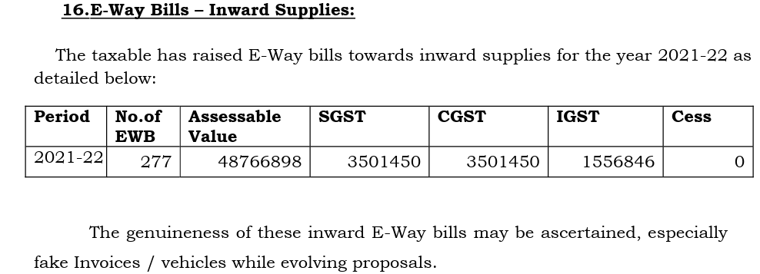
What kind of extra ordinary notices you come across in practice?

Slide 15
What kind of extra ordinary notices you come across in practice?

Slide 16
Casual SCNs - Sec 73 of C/SGST Act – National loss
No PH
No consideration of reply filed by tax payer
No service of valid notice or wrong SCN
Court sets asides the OIO
Court remands the OIO
Complete disrespect to
Time of the Court wasted
OIO set aside at last hour, closes the door for Sec 74 proceedings*
Notes:
Reply not considered – Case dismissed - [2024] 162 taxmann.com 156 (Calcutta) Lokenath Construction (P.) Ltd. v. Tax/Revenue, Government of West Bengal

Slide 17
Safari Retreats (P.) Ltd. v. Chief Commissioner of Central Goods & Service Tax -- 105 taxmann.com 324 (Orissa)
Input tax credit - Denial of - Construction of immovable property - High Court of Orissa by impugned order read down section 17(5)(d) to allow taxpayers to utilise input credit tax charged on goods and services consumed in construction of shopping mall for set off against CGST and Odisha GST payable on rent received from tenants
Revenue filed Special Leave Petition (SLP) against said order – HELD : SLP was to be granted and matter was to be listed on 20-4-2023 [Section 17 of Central Goods and Services Tax Act, 2017/Odisha Goods and Services Tax Act, 2017]

Slide 18
[2022] 138 taxmann.com 117
(Gujarat)/[2022]
92 GST 327
Munjaal Manishbhai Bhatt
v.
Union of India*
GST : In computing taxable value in construction contract, prescribing mandatory uniform rate of deduction of one third of total amount towards land value in terms of paragraph 2 of Notification No. 11/2017-Central Tax (Rate) instead of available actual price of land which can be determined, is ultra vires CGST Act and is discriminatory, arbitrary and violative of article 14 of Constitution of India as well
GST : Fixed deduction towards sale of land cannot be provided by way of notification where actual price is available; prescription under section 15(5) of CGST Act has to be by way of rules and not by notification
GST : GST is not payable on sale of developed land if such development activity has been undertaken before getting into an agreement with prospective buyer
Notes:
Para 126 of the decision refers to recipient’s right to receive refund. Referred Mafatlal Industries Ltd. v. Union of India [1997] 5 SCC 536

Slide 19
Well.
The Hon’ble High Court struck down
the specific provisions of
Notification No 11/2017 – CTR.
Whether the law makers reacted to the above mentioned?

Slide 20
[2018] 100 taxmann.com 501 (AAAR-KARNATAKA)
Columbia Asia Hospitals (P.) Ltd., In re
[2019] 71 GST 44
Corporate office and units are distinct persons under CGST Act, hence, activities performed by employees at corporate office in course of employment such as accounting, other administrative and IT system maintenance for units located in other States as well, shall be treated as supply as per Entry 2 of Schedule I read with section 7 of CGST Act, 2017

Slide 21
Whether the GST officials have really studied the impact of this angle? Ld. AG officials may study
Bulky administrative and commercial procurement at a hub point office
Large Corporates with multiple location units
Usage of procurement to various units in different states
ISD system is there; yet laziness causes non compliance
No trace of serious and in depth study by Revenue
Cool and focused approach will fetch good result/revenue

Slide 22
HIGH COURT OF PATNA
Gobinda Construction
v.
Union of India
[2023] 154 taxmann.com 311 (Patna) /
[2023] 99 GST 918
Sub-section (4) of section 16 of CGST/BGST Act is constitutionally valid and not violative of article 19(1)(g) and article 300-A of Constitution of India

Slide 23
[2024] 160 taxmann.com 667 (Madras)
HIGH COURT OF MADRAS
Thai Mookambikaa Ladies Hostel
v.
Union of India
Running private ladies hostels by providing residential accommodation and food to college students and working women on monthly basis with reasonable tariffs was exclusively for residential purpose; condition prescribed to claim exemption, viz., 'residential dwelling for use as residence' has been fulfilled
Hence, said services are covered under Entry Nos. 12 and 14 of Notification No. 12/2017-Central Tax (Rate), dated 28-6-2017 and, hence, exempted from levy of GST

Slide 24
[2021] 127 taxmann.com 736 (Gujarat)
HIGH COURT OF GUJARAT
Comsol Energy (P.) Ltd.
v.
State of Gujarat
[2021] 127 taxmann.com 736 (Gujarat)/[2021] 55 GSTL 390
Section 54 is applicable only for claiming refund of any tax paid under provisions of CGST Act and/or SGST Act; amount collected by revenue without authority of law is not considered as tax collected by them and, therefore, section 54 is not applicable
Notes:
Guj HC – Same decision - Louis Dreyfus Company India (P.) Ltd., Torrent Power Ltd. [2021] 130 taxmann.com 520 (Rajasthan) Shree Mahesh Oil Products Vs UoI (Rajasthan)

Slide 25
[2024] 162 taxmann.com 151 (Punjab & Haryana)
HIGH COURT OF PUNJAB AND HARYANA
Acme Cleantech Solutions (P.) Ltd.
v.
Union of India
162 taxmann.com 151 (Punjab & Haryana)[03-05-2024]
Effect and operation of Circular No. 204/16/2023-GST, dated 27-10-2023 regarding taxability of corporate guarantee by a person on behalf of another related person, or by holding company for sanction of credit facilities to its subsidiary company, to bank/ financial institutions shall remain stayed

Slide 26
[2024] 158 taxmann.com 593 (Madras)
HIGH COURT OF MADRAS
Eicher Motors Ltd.
v.
Superintendent of GST and Central Excise
158 taxmann.com 593 (Madras)/[2024] 81 GSTL 418
Where assessee had routinely deposited GST amount into Electronic Credit Ledger within due date, it would not be liable to pay interest even if assessee could not file monthly return in Form GSTR-3B within due date but filed belatedly

Slide 27
Sec 75 (4), ibid -
Whether Personal Hearing is the birth right of a Tax Payer who received SCN ?
An opportunity of hearing shall be granted where a request is received in writing from the person chargeable with tax or penalty, or where any adverse decision is contemplated against such person.

Slide 28
[2024] 159 taxmann.com 143 (Madras)
HIGH COURT OF MADRAS
Supreme Paradise
v.
Assistant Commissioner*
Where assessee was engaged in retail sale, discount offered by supplier/manufacturer to assessee could impact only transaction value of supplier and a further sale of goods by assessee at a discounted price could not form part of “transaction value” of assessee, unless such discount was on account of subsidy, thus order passed by authority demanding tax on discount was to be set aside

Slide 29
QUESTIONS?

Slide 30
THANK YOU!
- CA. PRASANNA KRISHNAN. V, CHENNAI

